Slide 1
Customer Loan Analysis
Miss. Prachi Waghmare
Mr. Parth Sutariya
Mr. Reman Thacker
Miss. Sneha Chogale
Miss. Akanksha Tiwari
Miss. Smitha P M
Miss. Arshdipkaur Gill
Mentor – Mr. Shubham Kabre
Group 5 Members:

Slide 2

Project Objective
This is Bank loan of Customers project where we were provided with 2 datasets with .csv extension files having 39k rows each and the objective was to analyze the growth that bank got within given years in loans.
We used MS-Excel, MySQL for analyzing, cleaning and removing duplicates from dataset and prepared dashboard using Tableau and Power BI tools where we did calculations, merging and prepared interactive dashboards.

Slide 3
Contents
KPI-1 : Year wise loan amount Stats
KPI-2 : Grade and sub grade wise revol_bal
KPI-3 : Total Payment for Verified Status Vs Total Payment for Non Verified Status
KPI-4 : State wise and last_credit_pull_d wise loan status
KPI-5 : Home ownership Vs last payment date stats

Slide 4
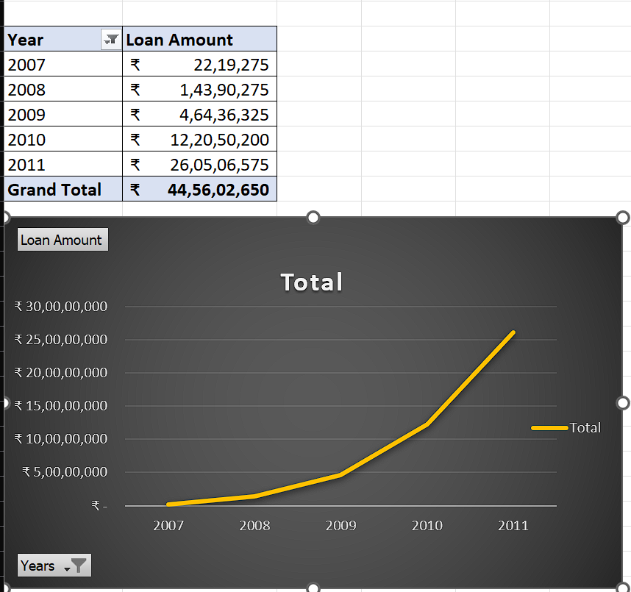
Year wise loan amount Stats
By observing the chart we can see how Loan Amount is increasing by year.
Starts from 2007 the loan amount is 22,19,275 and in the 2011 the loan amount is 26,05,06,575. We can subtract the new value to the old value to see the difference
26,05,06,575 - 22,19,275 = 258287300
258287300 increased in the duration of 4 years
And Grand Total of all years is 44,56,02,650.00

Slide 5
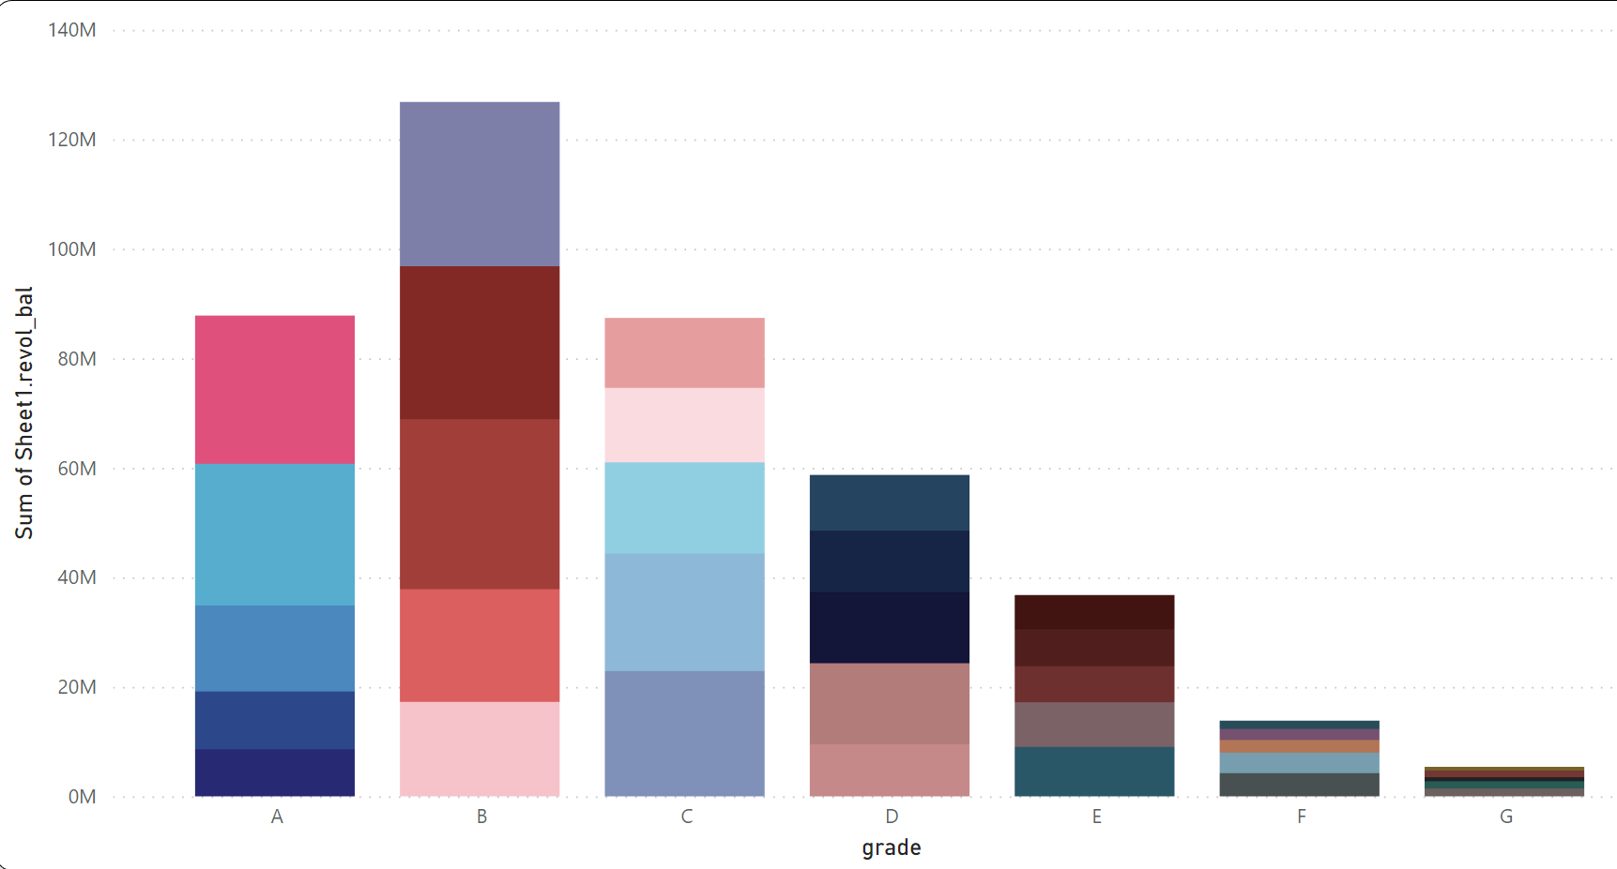
Grade and sub grade wise revol_bal
In this Grade and subgrade wise revol balance we can notice Grade-B have more revol balance then any other grade & Grade-G have very low revol balance.
As we can see that Grade B customers has higher annual income for 10+ yrs of employment period, so higher the annual income lower the Debt to income ratio and hence, more number of customers took loan in Grade B .
Similary, it goes for other grades also B>A>C>D>E>F>G order for revol bal as per annual income

Slide 6
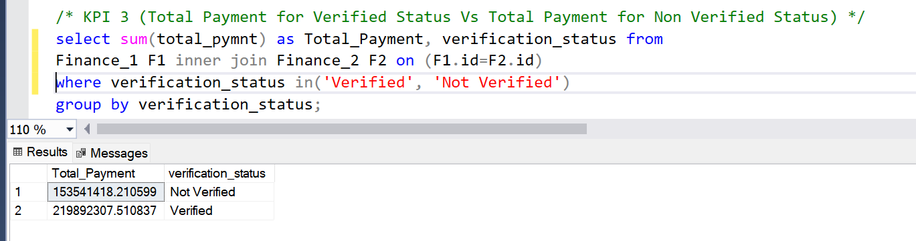
Total Payment for Verified Status Vs Non Verified Status
This is the first stage of the verification process. The bank needs a loan application to initiate the document collection and verification process
Looking at pie chart we can observe that verified status have 58.88% of total payment and 41.12% of total payment which are Not Verified for the Loan Amount

Slide 7
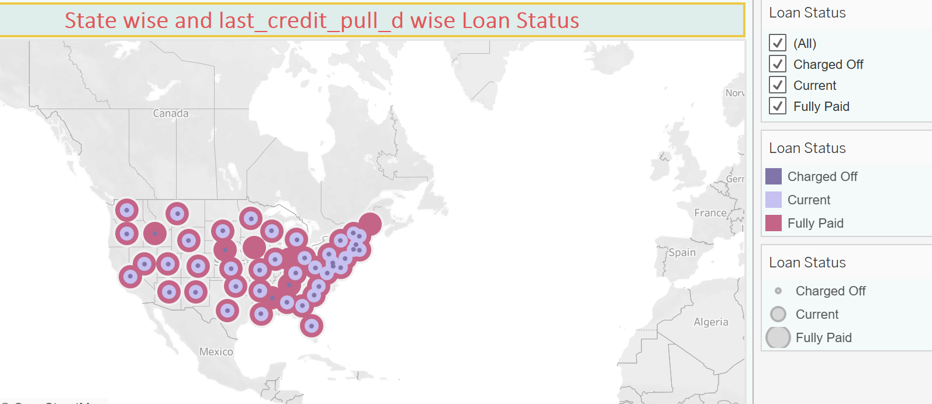
State wise and last_credit_pull_d wise loan status insights
The right graph shows the count of Loan Status in each state of USA on particular last credit pull date.
As we can see CA has given maximum customers who took Loan i.e >5000 is the count of loan status
This clearly shows that 97% of bank customers have fully paid status for each state.

Slide 8
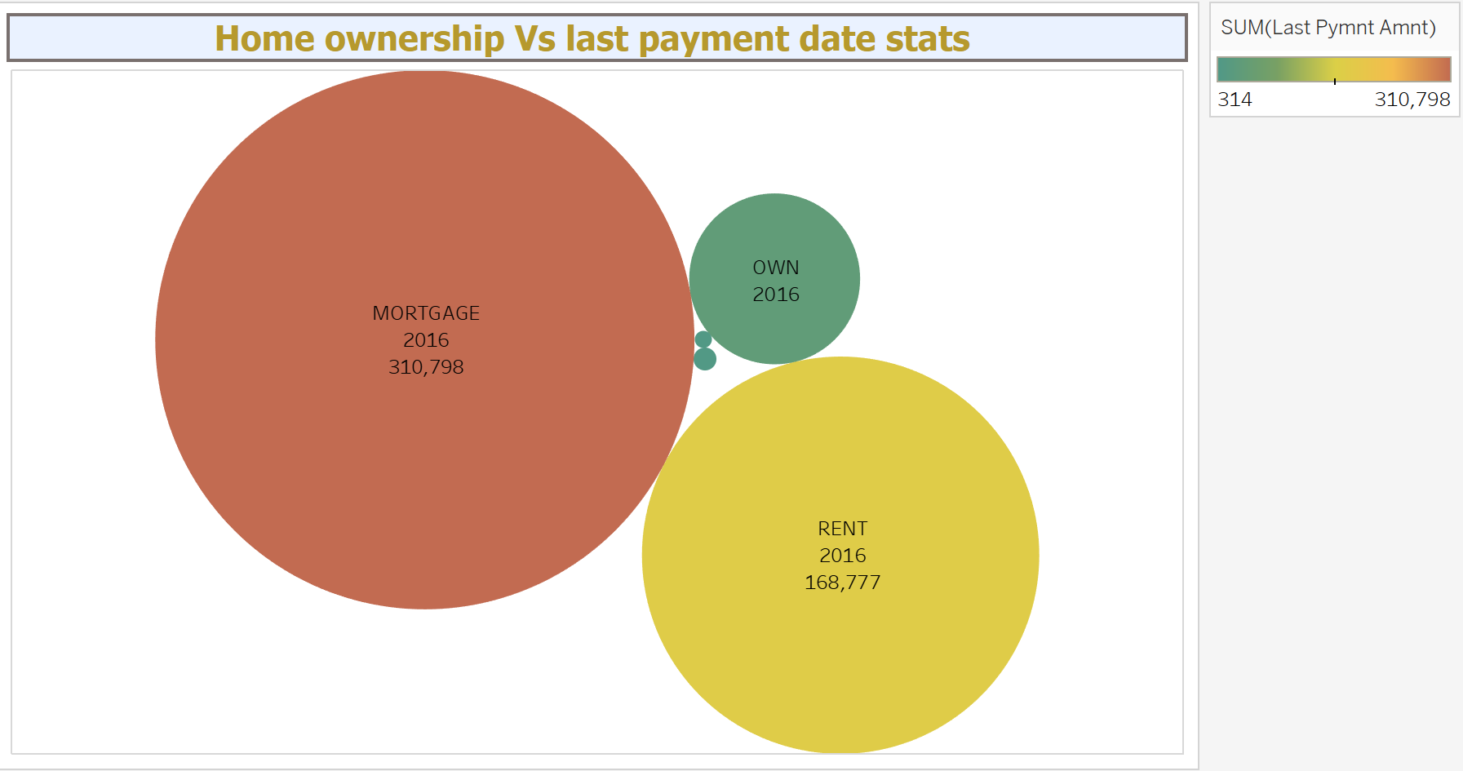
Home_ownership versus last payment date stats insights
The right graph shows the Home ownership and the amount paid for each on last payment date.
Here, we can see that maximum latest amount paid by customers with MORTGAGE home ownership is Rs.310,798.
It concludes that many of the customers are about to repay their loan amount for their particular home ownership.

Slide 9

Thank you
Bank of America
sales@boa.com

